Slide 1
Did educational level and geography affect the Asian lowest unemployment rate before covid19?
MENU
ANALYSIS
CONTACT
Data ANALYSIS
By Alissa Dao - 2022

Slide 2
2.7
MENU
ANALYSIS
CONTACT
Data ANALYSIS
was the Asian unemployment rate in 2019 and also the lowest unemployment rate among all race.

Slide 3
What accounts for the asian lowest rate of unemployment?
MENU
ANALYSIS
CONTACT
Geography
Educational level

Slide 4
TABLE OF CONTENT
Purposes of the project
Data processing
01
02
Data analysis
Advice
03
04
MENU
ANALYSIS
CONTACT
Data ANALYSIS
What the audiences will gain after this project
Get details about the data used in this project and how I processed them
Find out the meaning of data
Advices for improvement

Slide 5
The purposes of the project
01
MENU
ANALYSIS
CONTACT
Data ANALYSIS
Alissa Dao

Slide 6
Unemployment in america
affects the economy
Damages personal aspects
MENU
ANALYSIS
CONTACT
Data ANALYSIS
spend less
accrue more debt
higher payments from state and federal governments (food stamps)
mental and physical health problems
detrimental changes in family relationships
psychological well-being of partners and children

Slide 7
UNDERSTANDING the influence of educational level and geography on asian unemployment rate
Make Wise investment
Boost life quality of other races
MENU
ANALYSIS
CONTACT
Data ANALYSIS
More effective and high-quality workforce
Pay attention to needed areas
Apply the success of Asia to other races

Slide 8
Data processing
02
MENU
ANALYSIS
CONTACT
Data ANALYSIS
Alissa Dao

Slide 9
What data did I use?
Unemployment rate by race
Educational attainment by race
Population by race in all states
Unemployment rate by educational attainment
Economically distressed states
MENU
ANALYSIS
CONTACT
Data ANALYSIS

Slide 10
Unemployment rates by race (1973-2019)
MENU
ANALYSIS
CONTACT
Data ANALYSIS
source
4 columns
US Bureau of Labor Statistics
Asia, Hispanic or Latino, White, and Black or African American
48 rows
Data cleaning
From 1973 to 2019
Delete data from 1973 to 1999: lack Asian data

Slide 11
Educational attainment of the labor force age 25 and older by race (2019)
MENU
ANALYSIS
CONTACT
Data ANALYSIS
4 rows
source
Asia, Hispanic or Latino, White, and Black or African American
US Bureau of Labor Statistics
4 columns
Less than a high school diploma
High school graduates, no college
Some college, no degree
Associate's degree
Bachelor's degree and higher
Data cleaning
No action needed

Slide 12
unemployment rate by educational attainment, 2019
MENU
ANALYSIS
CONTACT
Data ANALYSIS
source
2 columns
US Bureau of Labor Statistics
Educational attainment, Unemployment rate
4 rows
Less than a high school diploma
High school graduates, no college
Some college, no degree
Associate's degree
Bachelor's degree and higher
Master’s degree
Professional’s degree
Doctoral Degree
Data cleaning
No action needed

Slide 13
STATES HAVE THE HIGHEST PERCENTAGE OF POPULATION LIVING IN ECONOMIC DISTRESS
MENU
ANALYSIS
CONTACT
Data ANALYSIS
source
2 columns
The Economic Innovation Group (EIG)
States (Abbreviation), Percentage of population living in economic distress
51 rows
51 states
Data cleaning
- Using VLOOKUP to match abbreviation with full states’ name

Slide 14
Population by race and ethnicity in all states
MENU
ANALYSIS
CONTACT
Data ANALYSIS
source
52 columns
US Census Bureau
Label(name of different ethnicity), 51 States
71 rows

Slide 15
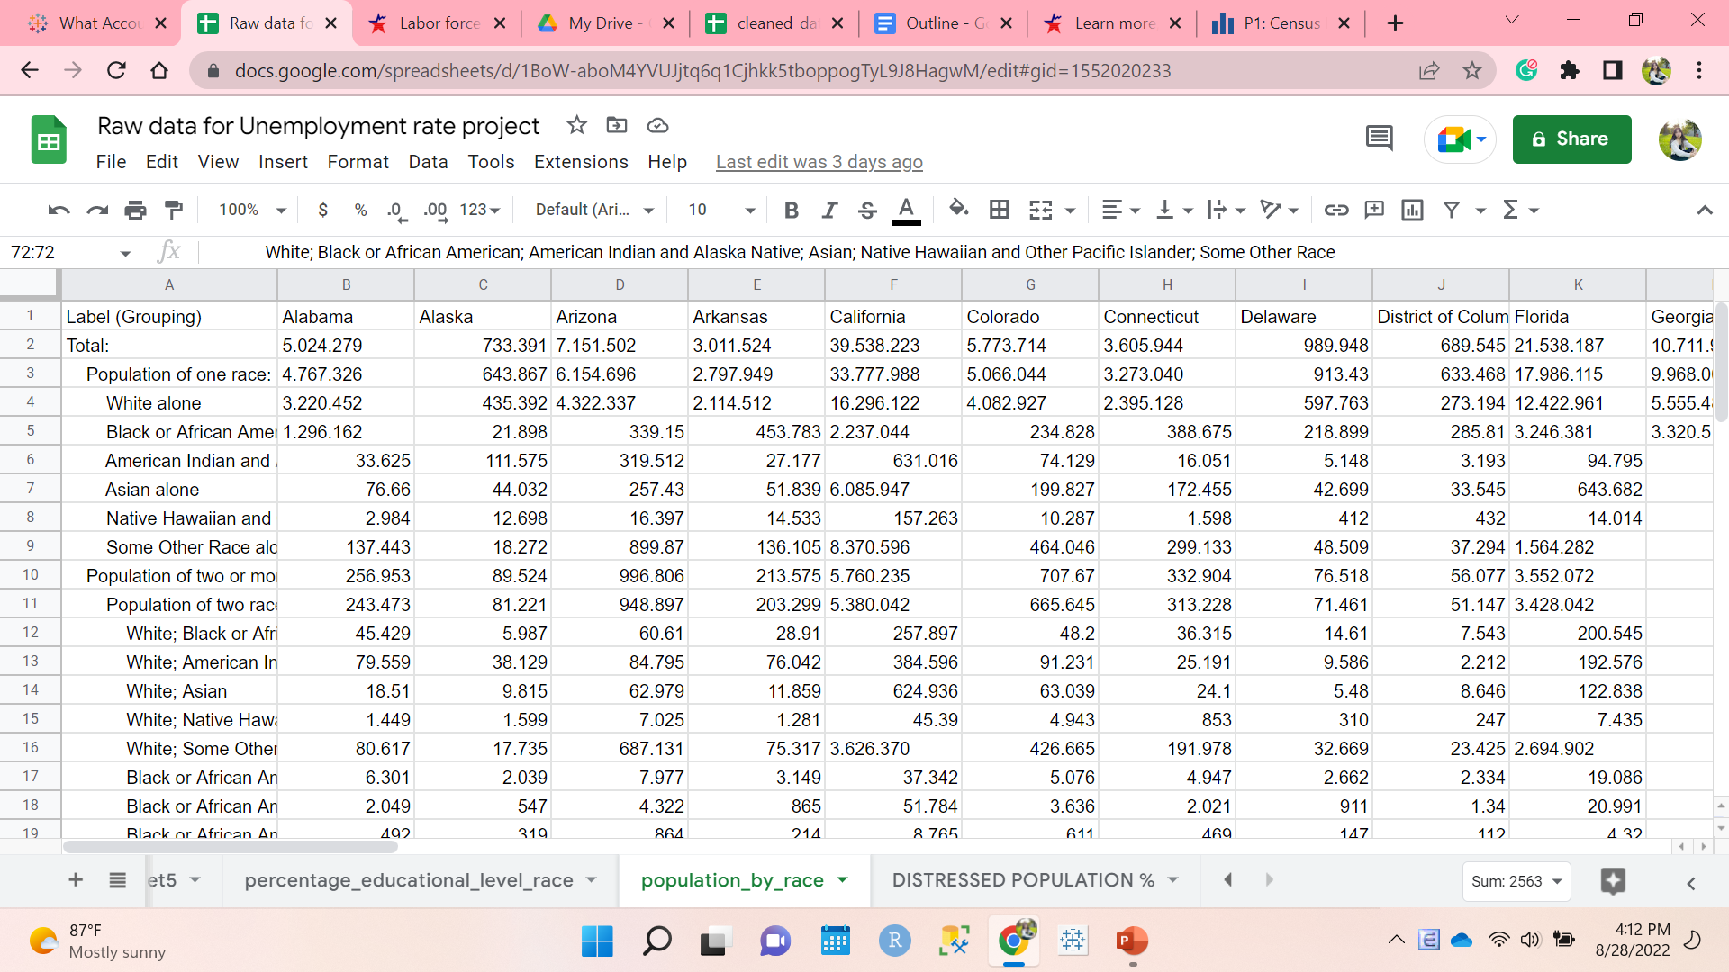
MENU
ANALYSIS
CONTACT
Data ANALYSIS
Data Cleaning: Raw data

Slide 16
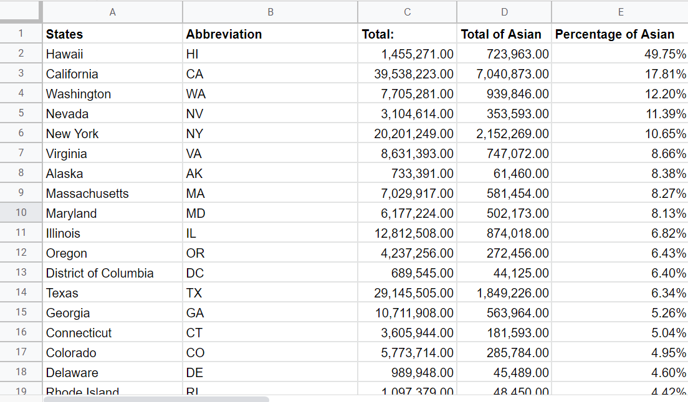
Data cleaning: cleaned data
MENU
ANALYSIS
CONTACT
Data ANALYSIS
Keeping only Asian origin:
Created a filter: filter by condition: text does not contain: Asia
Deleted all rows that matched the created filter.
Had only Asian origin left.
Transporting columns to rows:
Copied the current table
Chose paste special: transposed
Deleted the old table
Calculting the total population and percentage of all Asian ethnicity:
Total: Used SUM function
Percentage: Results from SUM function/Total

Slide 17
Data analysis
03
MENU
ANALYSIS
CONTACT
Data ANALYSIS
Alissa Dao

Slide 18

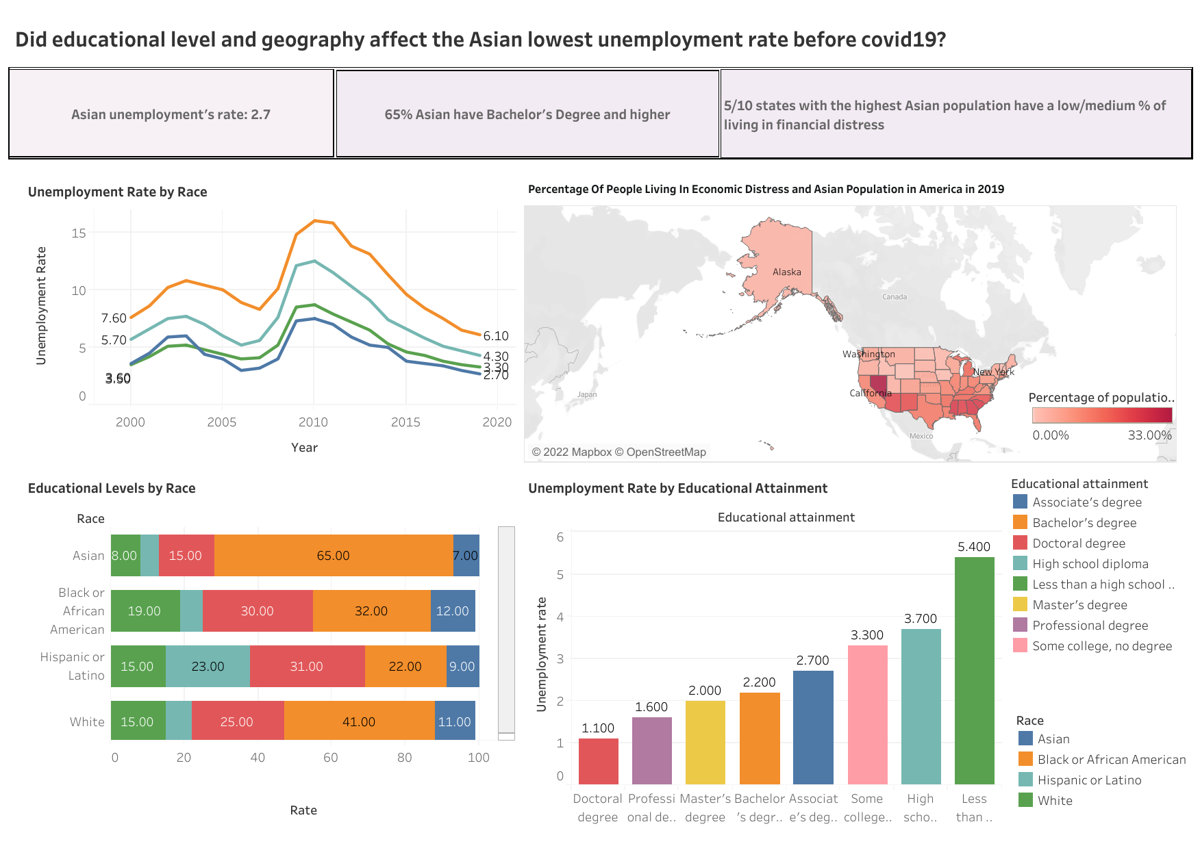
MENU
ANALYSIS
CONTACT
Data ANALYSIS

Slide 19
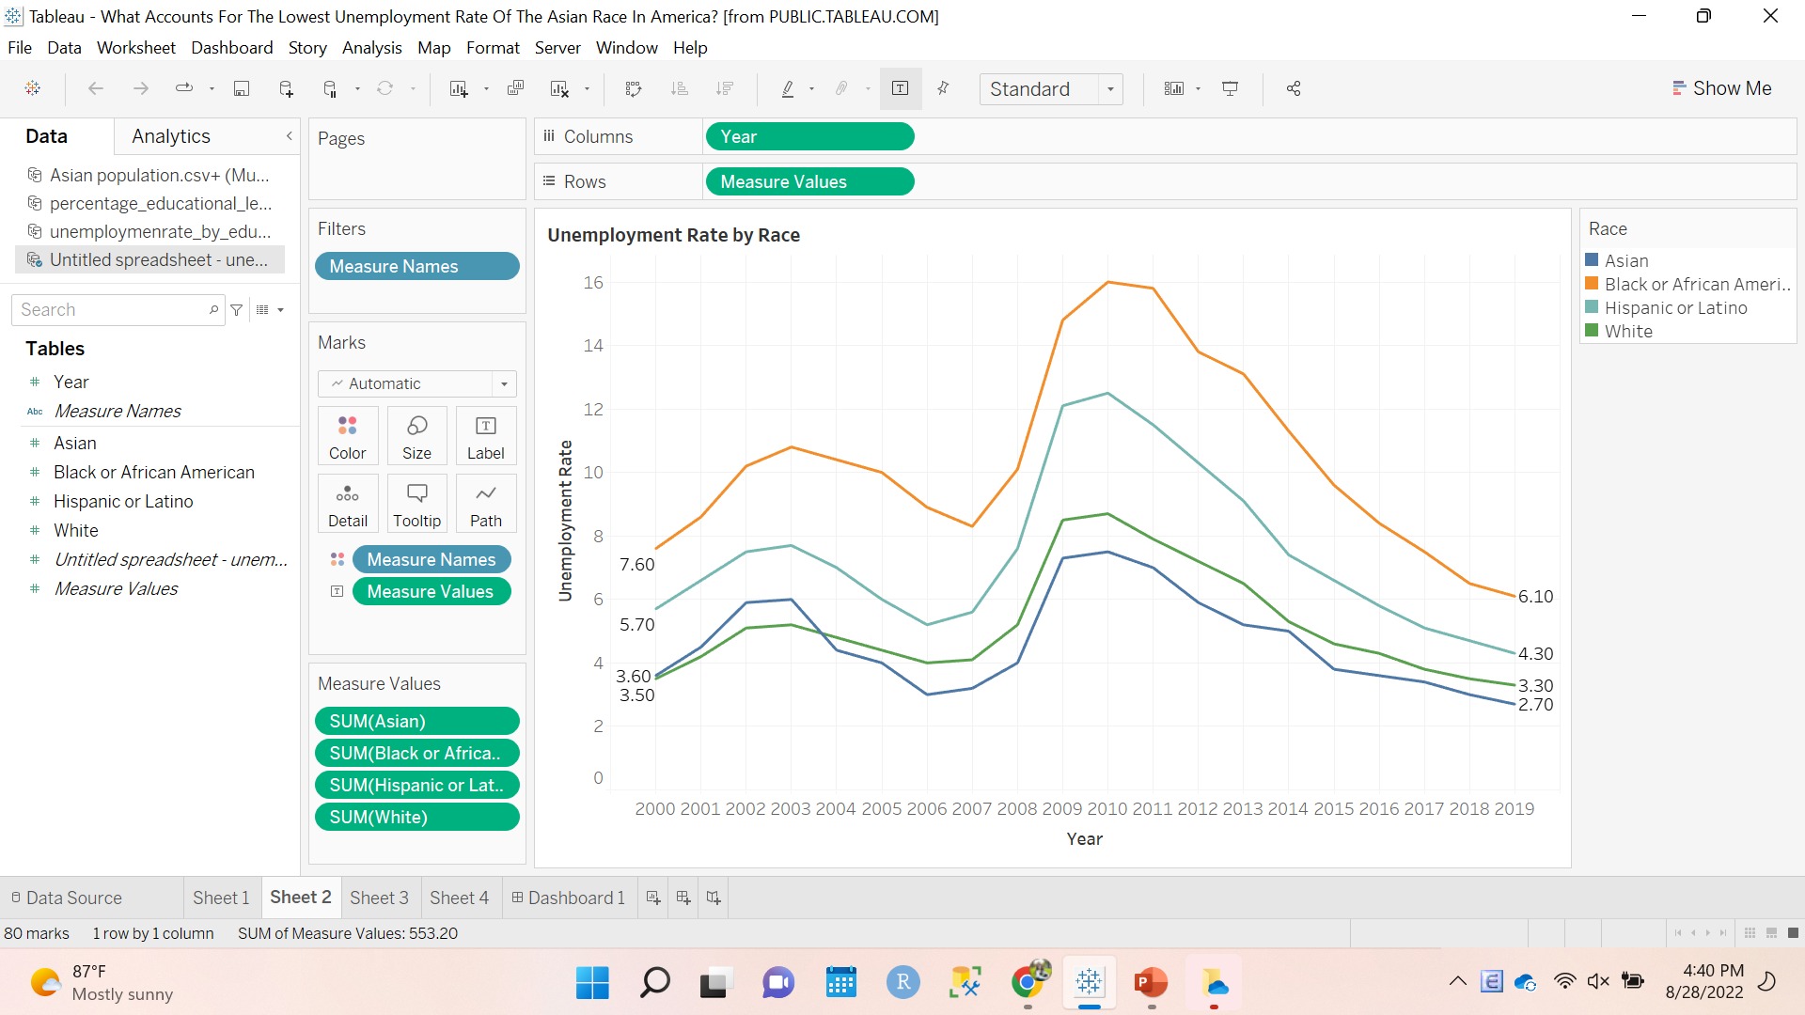
1. Unemployment rate by race
MENU
ANALYSIS
CONTACT
Data ANALYSIS
Asia had the lowest unemployment rate for most of the time: 15 years
The Asian highest unemployment rate was 7.5 (2010). This number was the smallest among others.
The Asian lowest unemployment rate was 2.7 (2019).

Slide 20
What is the role of geography?
MENU
ANALYSIS
CONTACT
Data ANALYSIS

Slide 21
5/10
MENU
ANALYSIS
CONTACT
Data ANALYSIS
states with the highest Asian population have a low/medium % of living in financial distress

Slide 22
7 metrics to identify economic distress
MENU
ANALYSIS
CONTACT
EDUCATIONAL ATTAINMENT
01
02
HOUSING VACANCY RATE
Percent of population 25 years and over with a high school degree
Percent of habitable housing that is unoccupied
UNEMPLOYMENT RATE
03
04
POVERTY LEVEL
The share of the labor force that is unemployed.
Percent of population living under the poverty line.

Slide 23
7 metrics to identify of economic distress
MENU
ANALYSIS
CONTACT
MEDIAN INCOME RATIO
05
06
PERCENT CHANGE IN EMPLOYMENT
Ratio of the zip code’s median income to the state's median income.
Percent increase/decrease in the number of individuals employed.
07
PERCENT CHANGE IN ESTABLISHMENTS
Percent change in number of business establishments within zip code.

Slide 24
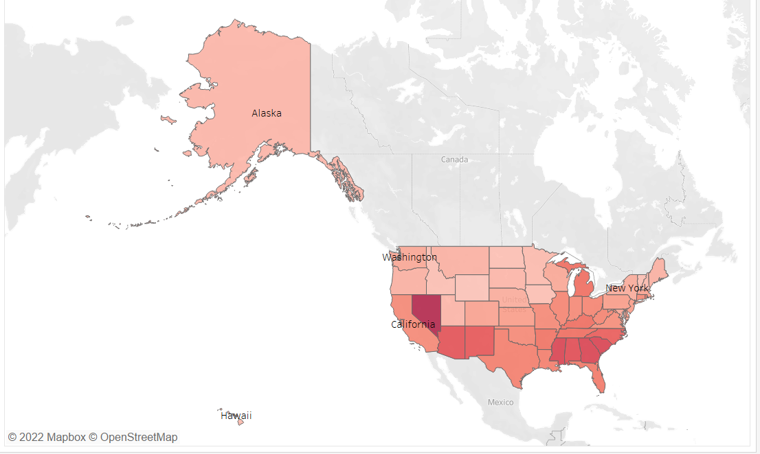

2. Percentage Of People Living In Economic Distress and Asian Population in America
MENU
ANALYSIS
CONTACT
Data ANALYSIS
States | % Asia | % distressed
Hawaii | 49.75 | 2
California | 17.81 | 12
Alaska | 8.38 | 2
Washington | 12.2 | 6
New York | 10.65 | 5
Asia usually live in states with low % of people living in economic distress.

Slide 25
Advantages of living in areas with low % people living in economic distress
Better living environment
More chances in job hunting
MENU
ANALYSIS
CONTACT
Data ANALYSIS

Slide 26
What is the role of educational attainment?
MENU
ANALYSIS
CONTACT
Data ANALYSIS

Slide 27
2.2
MENU
ANALYSIS
CONTACT
Data ANALYSIS
Is the rate of unemployment for people with bachelor’s degree

Slide 28
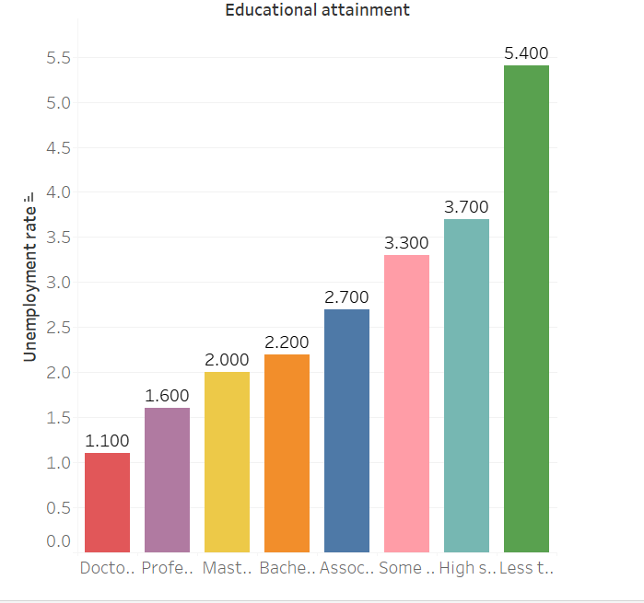
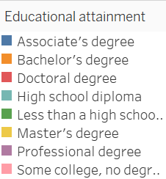
3. Unemployment Rate by Educational Attainment
MENU
ANALYSIS
CONTACT
Data ANALYSIS
A higher degree is associated with a lower unemployment rate.
The unemployment rate for people with Bachelor’s degree or higher is below 2.2

Slide 29
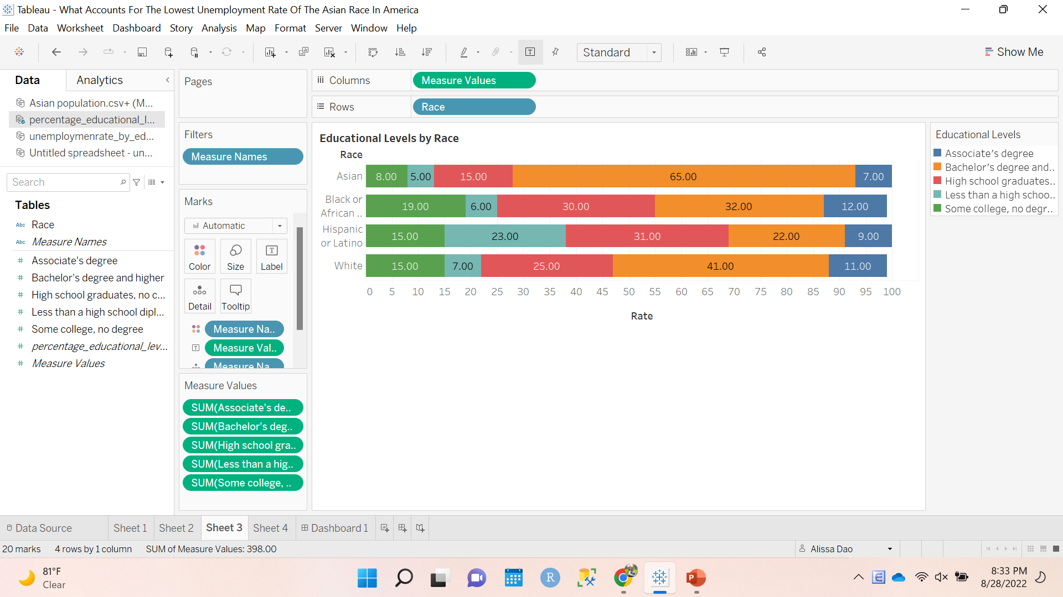
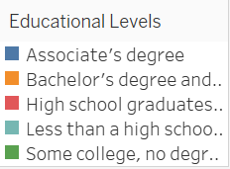
4. Educational Levels by Race
MENU
ANALYSIS
CONTACT
Data ANALYSIS
Asia had the highest percent of people with Bachelor’s degree or higher: 65%
Asia also had the lowest percent of people with some college, no degree

Slide 30
Education does make difference
More skillful workers
More working opportunities
MENU
ANALYSIS
CONTACT
Data ANALYSIS

Slide 31
advice
04
MENU
ANALYSIS
CONTACT
Data ANALYSIS
Alissa Dao

Slide 32
What have we learned?
Open the gate for a better education
Invest more in financial distressed areas
MENU
ANALYSIS
CONTACT
Data ANALYSIS
Encouraging people to complete at least Bachelor’s degree
Eradicating the barriers that prevent people from going to school (tuition,…)
Designing practical curriculum
Creating more working opportunities
Increasing the living standard
Facilitating for startups, companies to grow

Slide 33
Thanks for listening!
MENU
ANALYSIS
CONTACT
Data ANALYSIS
Alissa Dao: daoan@dickinson.edu

